Slide 1
up
down
anthelmintic | niclosamide, pyrvinium, mebendazole, bithionol, ivermectin

Slide 3
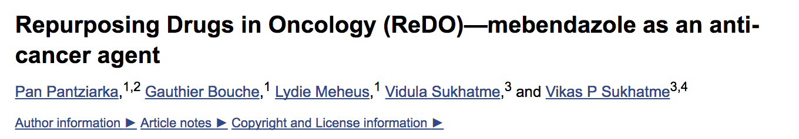
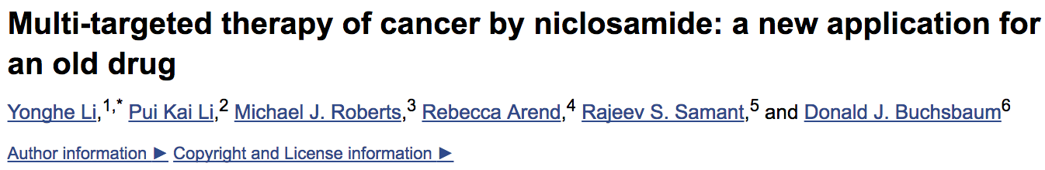
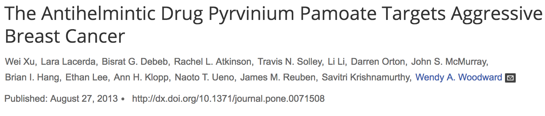

Slide 4
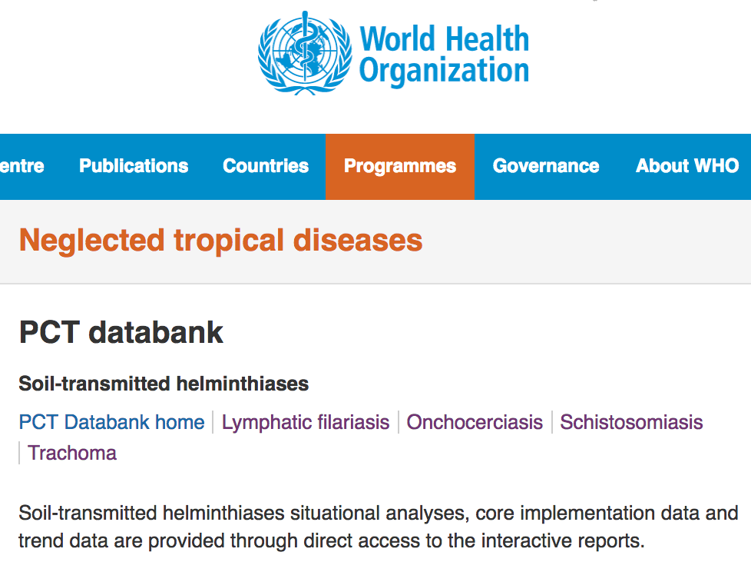
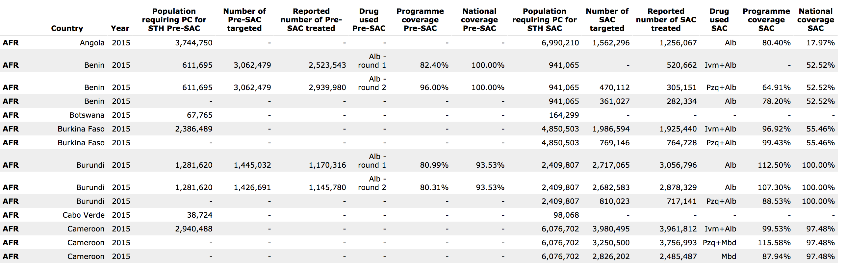

Slide 5
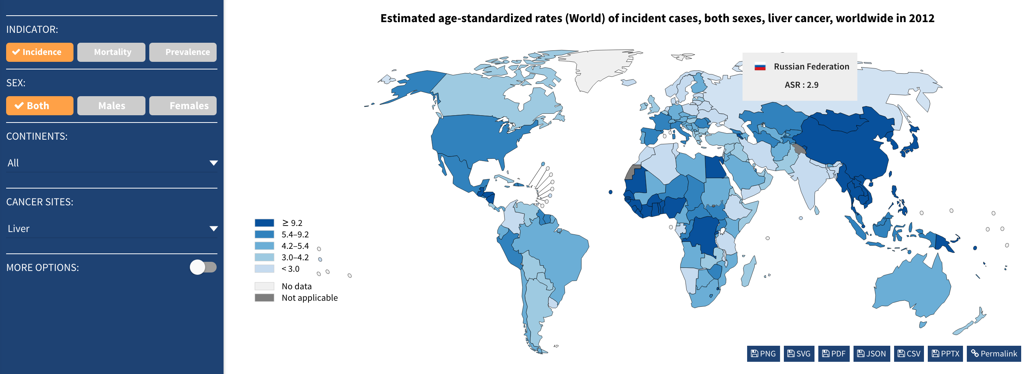

Slide 6
Feature | Correlation | P
Population.requiring.PC.for.STH.PreSAC | -0.11 | 7.654e-05
Number.of.PreSAC.targeted | -0.05 | 0.28
Reported.number.of.PreSAC.treated | -0.19 | 2.655e-07
Programme.coverage.PreSAC | -0.247 | 6.26e-07
National.coverage.PreSAC | -0.328 | < 2.2e-16
Population.requiring.PC.for.STH.SAC | -0.119 | 3.382e-05
Number.of.SAC.targeted | -0.097 | 0.1507
Reported.number.of.SAC.treated | -0.081 | 0.01768
Programme.coverage.SAC | -0.059 | 0.3807
National.coverage.SAC | -0.008 | 0.8077
Notes:
2010

Slide 7
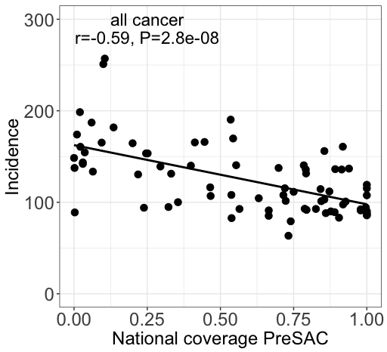
Notes:
Coefficients:
Estimate Std. Error t value Pr(>|t|)
(Intercept) 175.3351 51.9823 3.373 0.00119 **
National.coverage.PreSAC -66.0553 11.8854 -5.558 4.23e-07 ***
poverty -0.5148 2.0560 -0.250 0.80299

Slide 8
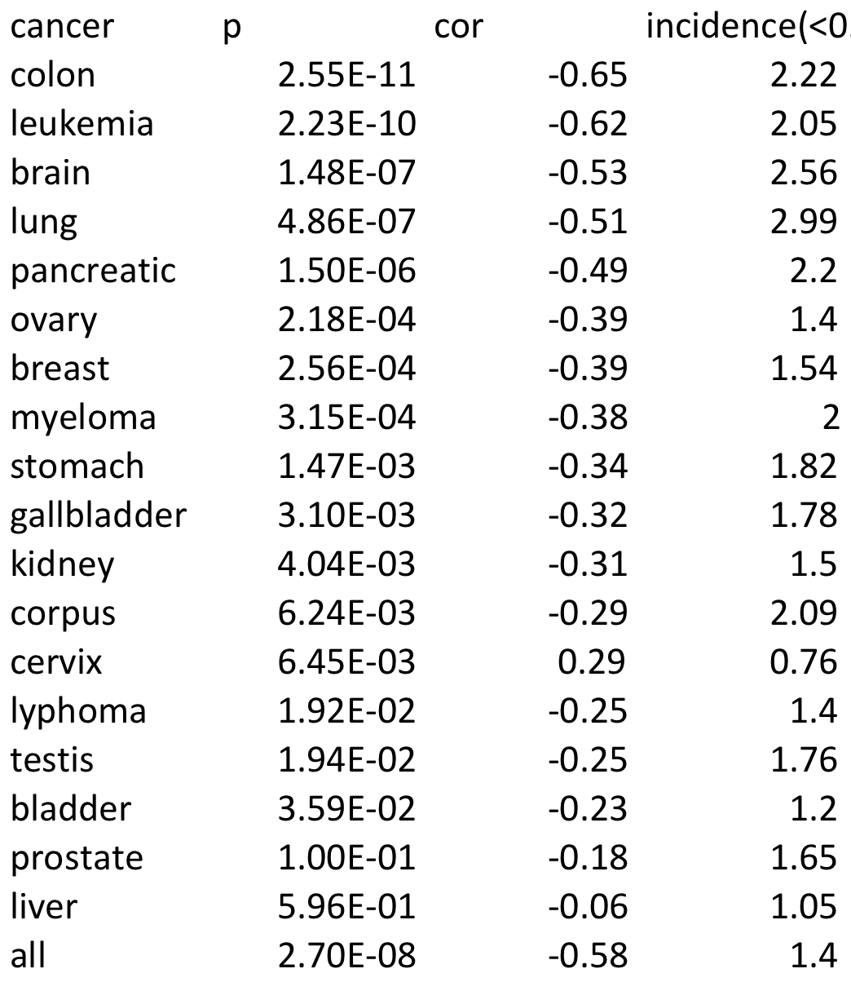

Slide 9
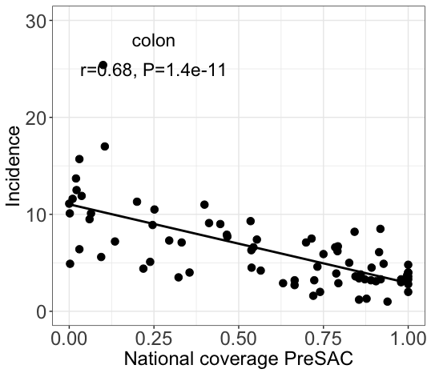

Slide 10
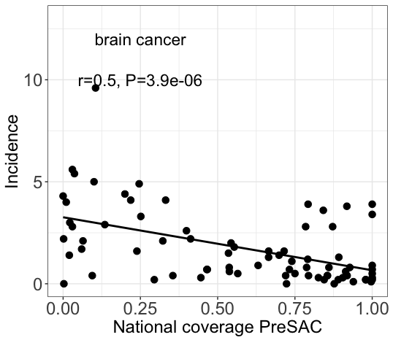

Slide 11
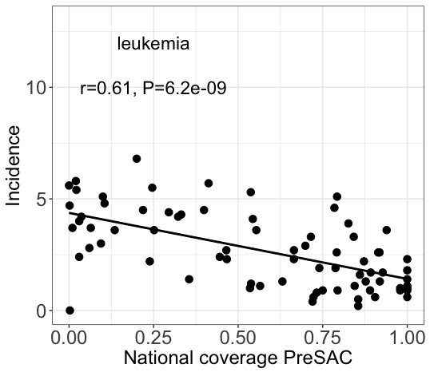

Slide 12
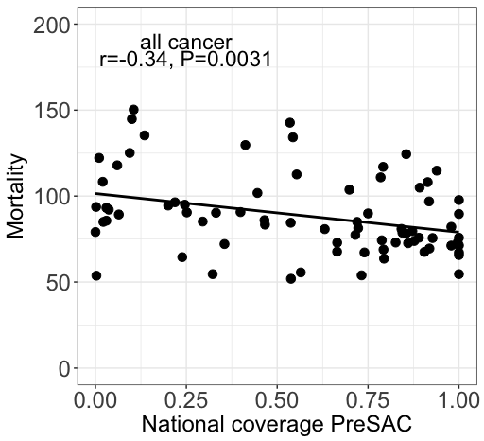

Slide 13
